Slide 1

UNIVERSIDAD POLITÉCNICA DE MADRID
ESCUELA TÉCNICA SUPERIOR DE INGENIEROS DE TELECOMUNICACIÓN MÁSTER UNIVERSITARIO EN INGENIERÍA BIOMÉDICA
Design and development of a novel pipeline for resting-state functional magnetic resonance imaging processing
Alumno : Juan José Pautasso
Tutor : Héctor José Bueno Zamora
Co – tutor : Luis Marcos Vidal
Ponente : Patricia Sánchez González

Slide 2

Motivation
The H2H project is carried out by a CNIC research group that aims to unravel the relationship between cardiovascular and neurocognitive diseases.
The pipelines must be able to obtain correlation matrices to determine functional connectivity and the degree of correlation between brain regions.
In collaboration with the project, a versatile tool will be developed, capable of processing R-fMRI data in an automatic and optimized way.
Two groups of subjects will be analyzed to validate the pipeline.

Slide 3
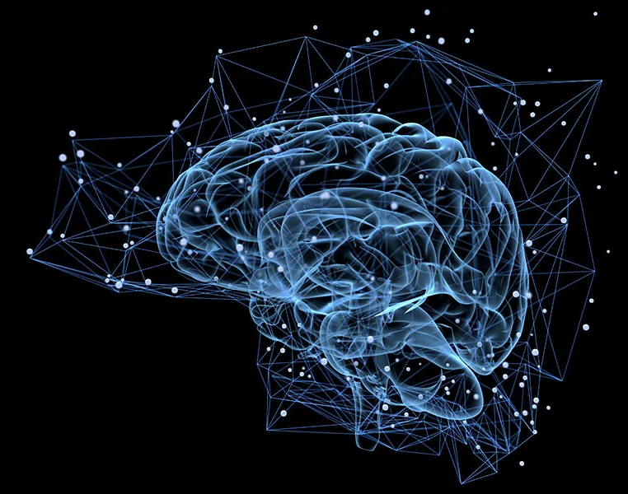
Index of the presentation
Introduction
Preprocessing
Processing
Practical case
Conclusions
Future lines

Slide 4
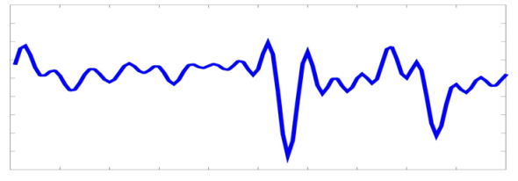
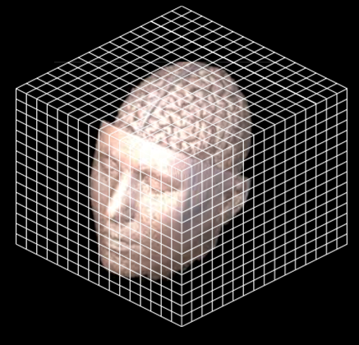
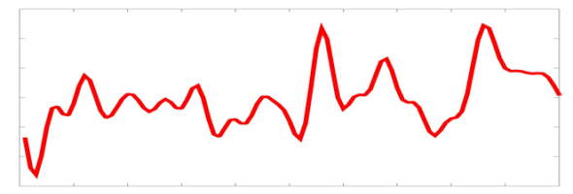
Introduction
Resting state – functional Magnetic Resonance Image (R-fMRI)
Signal BOLD in voxel 1
Synchronization in the
activation of voxels.
Magnetic Resonance Image
Signal BOLD in voxel 2
Functional connectivity
1

Slide 5
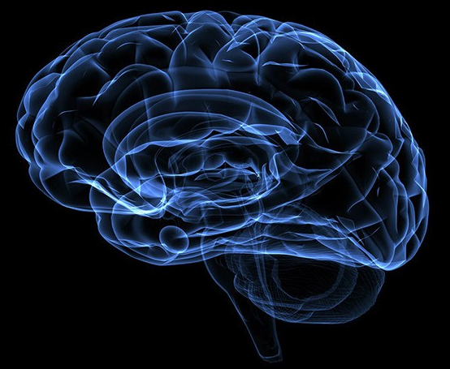
Preprocessing
Why fMRI preprocessing is necessary ?
Movements of the subject inside the scanner
Inhomogeneities in the magnetic field
Swallowing
Heartbeats
Breathing
Others
2

Slide 6


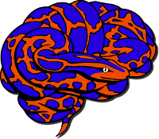
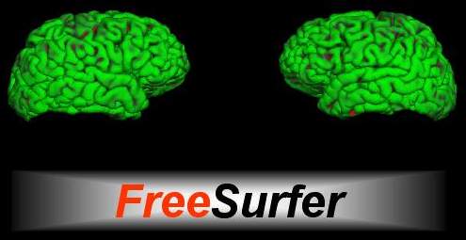

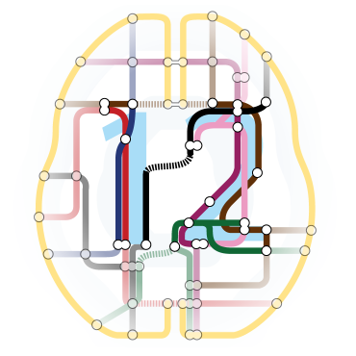
Preprocessing
What software alternatives are possible to use?
Commercial
BrainVoyager
SPM - MATLAB
Others
Open source
FSL
AFNI
ANTs
FreeSurfer
How to merge their functions?
Python Nipype Library
3

Slide 7
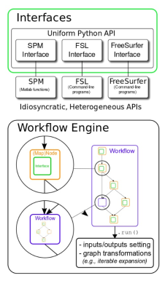
Python's Nipype Library
It offers the opportunity to analyze images using a variety of different algorithms.
Nipype allows to easily interact and combine tools from different neuroimaging software packages and facilitates interaction between these packages within a single workflow.
Reduces the learning curve required to use different packages.
Allows data to be processed faster by running it in parallel on many cores/machines.
It is possible to organize the results in folders and delete any result that is not used avoiding storage problems.
4

Slide 8
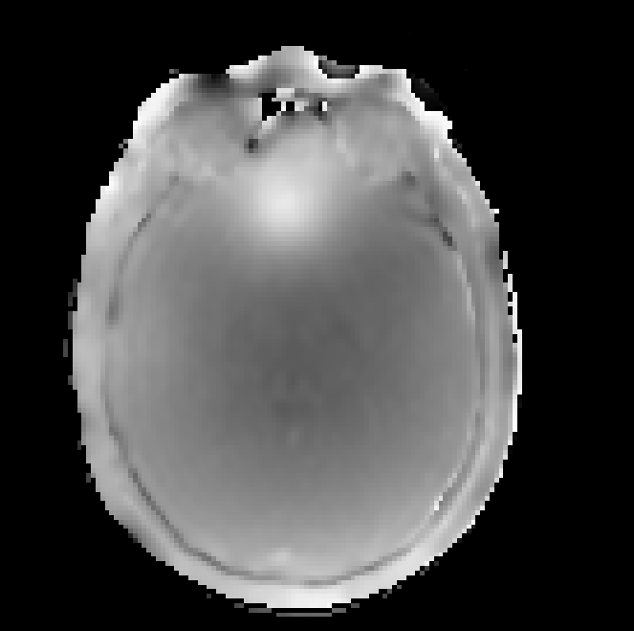
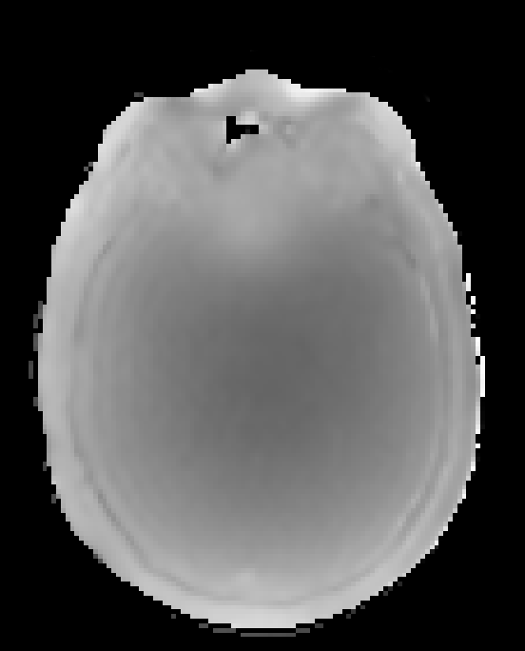
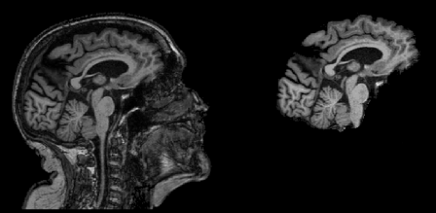
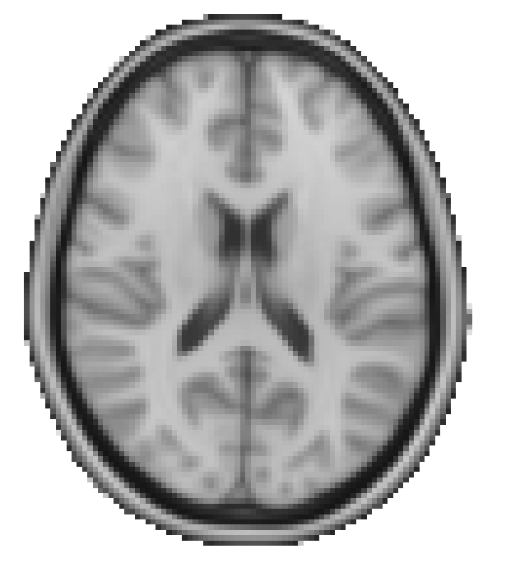
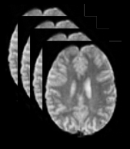
Nipype Library
Data Organization
Create the folder in which the results obtained for each subject will be stored and where the input images necessary for the operation of the pipeline will be stored.
Input Images required by the pipeline:
BO_I
BO_II
T1
Template
Resting
5

Slide 9
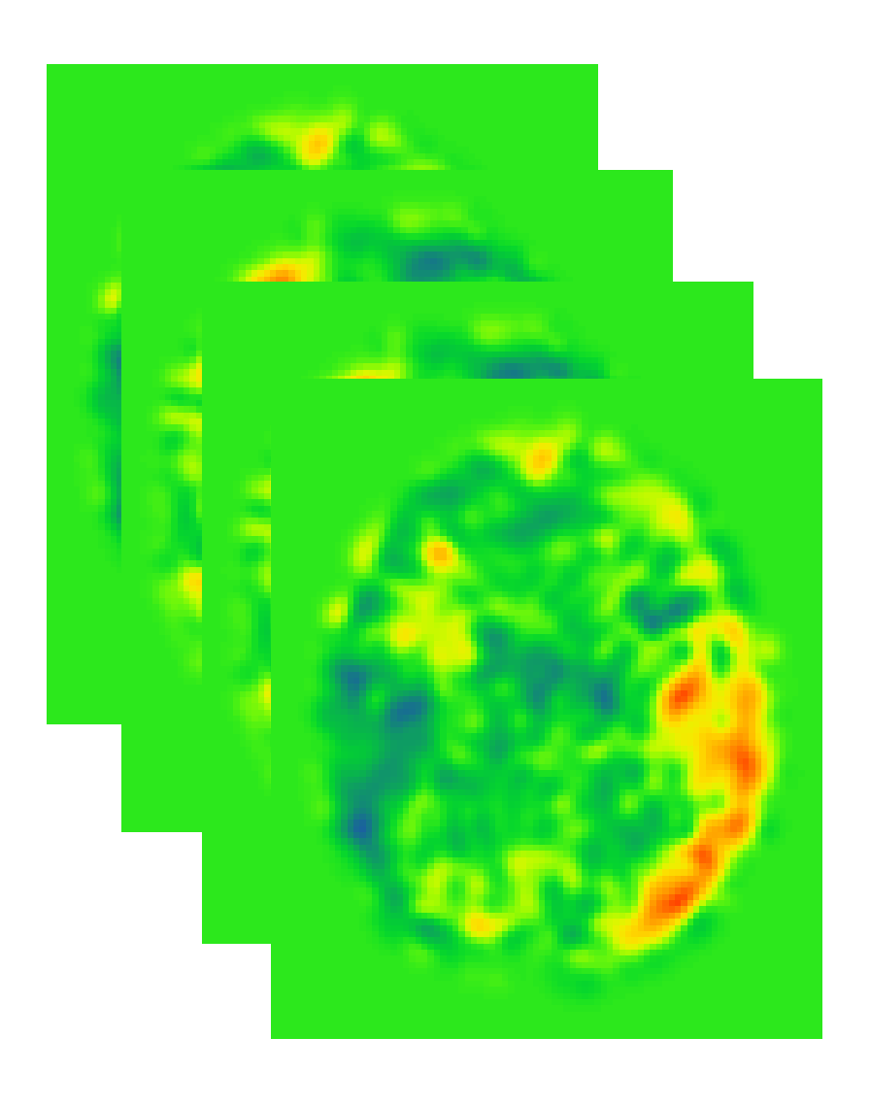
Preprocessing
R – fMRI
Output GLM
Motion
Correction
Epi
Register
Filters
Field Map
Obtention
Spatial
Normalization
GLM​
6

Slide 10
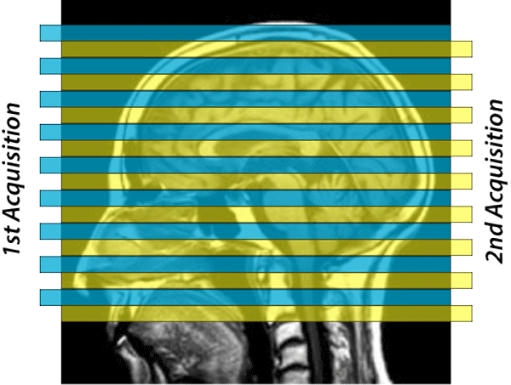
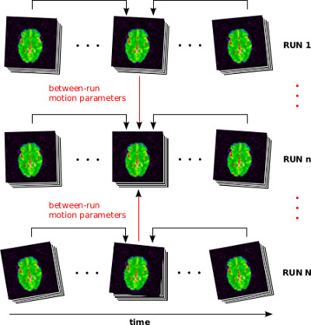

Motion correction
SpaceTimeRealigner
7

Slide 11
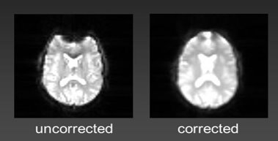
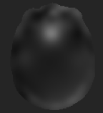
Field Map
Original EPI image
Field Map
EPI image corrected
8

Slide 12
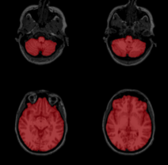
Epi Register
EPI Register
Native Space
T1 Space
9

Slide 13
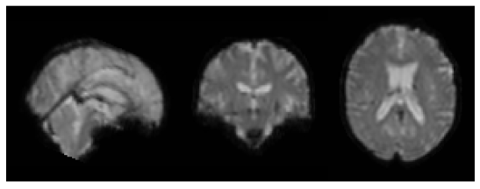
Spatial Normalization
EPI to T1
Apply
Native Space
T1 Space
Concatenate both
transformation matrices
T1 to MNI
Image obtained
MNI Space
T1 Space
Template - MNI Space
10

Slide 14
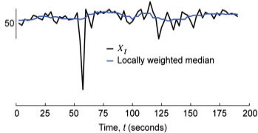
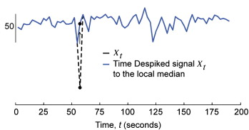
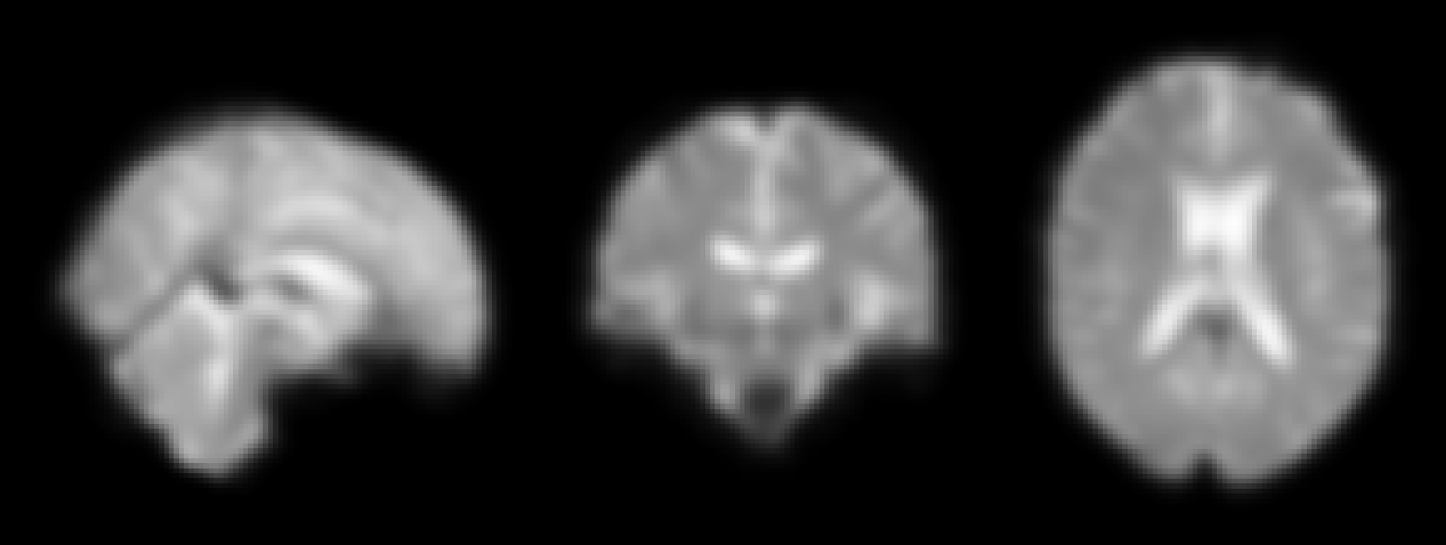
Filters
Original signal
Despiked signal
Original image
Smoothing
11

Slide 15
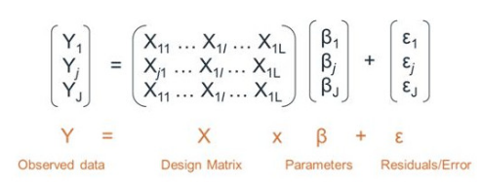
General Linear Model
Y response in each voxel is modeled as a linear combination of predictors, stored in the columns of a design matrix X times β. Then, to eliminate the variability of these components, the residues from this model are assigned as the new voxel time series.
Output GLM
12

Slide 16
Processing
Why fMRI processing is necessary ?
It is not possible to obtain valuable information for analysis purposes in visual form.
It is necessary to obtain correlation matrices in order to quantify the relationship between brain regions.
The correlation matrix will allow a quantitative analysis of the degree of correlation for each region of interest.
13

Slide 17
Workflow for processing
Atlas
Signal
Extraction
Correlation
Matrix
Final
Result
Masker
Select
Label
Vectorization
WPP
GLM
Image
14

Slide 18
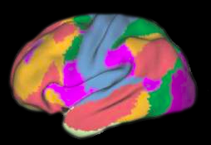
Workflow for processing
Atlas
Signal
Extraction
Correlation
Matrix
Final
Result
Masker
Select
Label
Vectorization
WPP
GLM
Image
15

Slide 19
Workflow for processing
Atlas
Signal
Extraction
Correlation
Matrix
Final
Result
Masker
Select
Label
Vectorization
WPP
GLM
Image
...
...
n= Regions of interest
n= All atlas regions
16

Slide 20
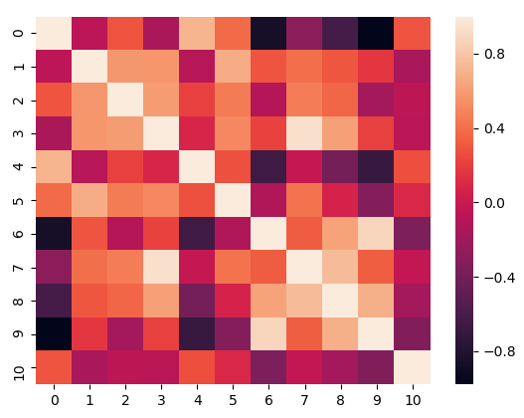
Workflow for processing
Atlas
Signal
Extraction
Correlation
Matrix
Final
Result
Masker
Select
Label
Vectorization
WPP
GLM
Image
17

Slide 21
Workflow for processing
Atlas
Signal
Extraction
Correlation
Matrix
Final
Result
Masker
Select
Label
Vectorization
WPP
A1
A2
.
.
.
An
GLM
Image
18

Slide 22
Practical Case
Two groups with 59 patients were analyzed. The first group is the control group (27 subjects) and the second group (32 patients) is composed of patients with mild cognitive impairment.
The case of study is the analysis of the Default Mode Network (DMN)
The DMN analysis will allows to evaluate if there are differences in the functional connectivity between both groups of patients analyzed.
19

Slide 23
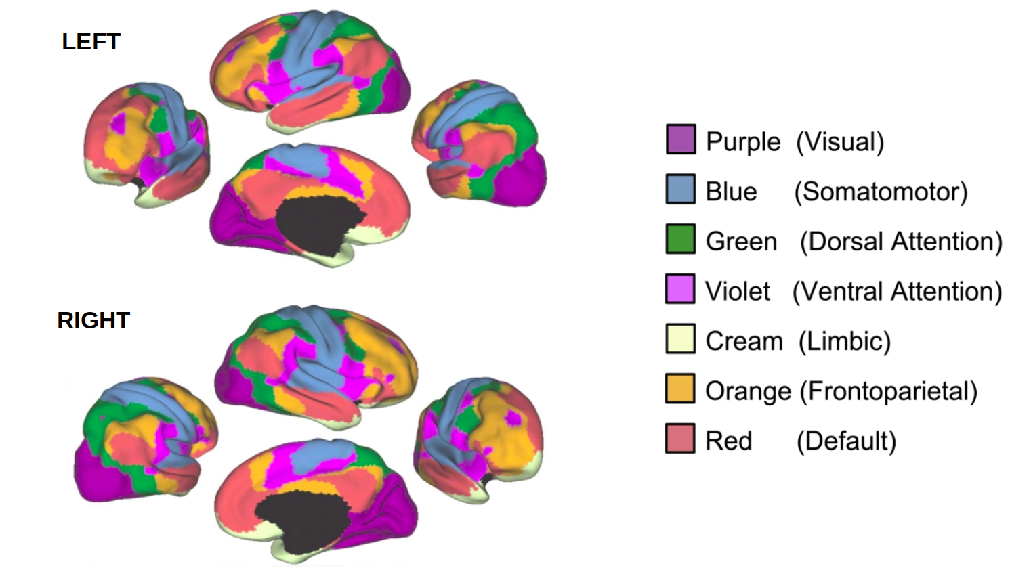
Default Mode Network
Reference: Network Cortical Parcellation (Thomas Yeo et al., 2011)
20

Slide 24
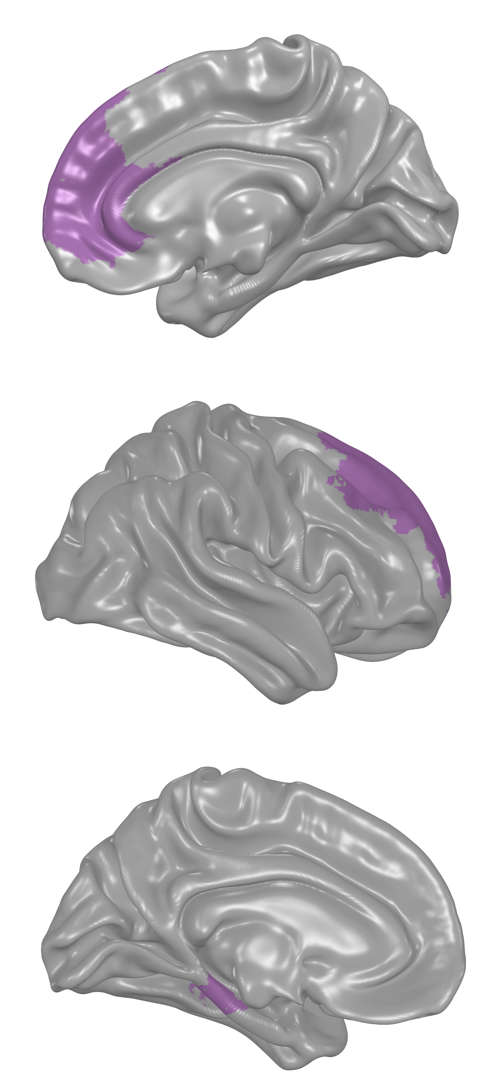
Results
It was found that there are differences in connectivity between the control group and the group with mild cognitive impairment.
The difference is found between the left hippocampus and the right – middle prefrontal cortex.
The null hypothesis is rejected.
There are less connectivity between regions in the group with mild cognitive impairment with respect to the control group.
21

Slide 25
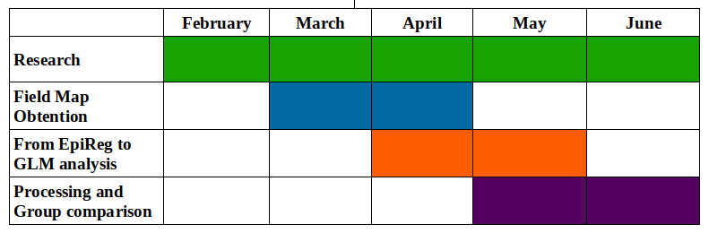
Practical Case
Organization of tasks
 | February | March | April | May | June
Research
Field Map Obtention
From EpiReg to GLM analysis
Processing and Group Comparison
22

Slide 26
Practical Case
Economical Budget
 | Number | Costs | Total (€)
Image acquisition | 59 subjects | 400 € (per scan) | 23.600 €
Personal | 1 Person Per Month (PPM) | 2500 € | 12.500 €
Other goods and services | - | - | 1000 €
Direct costs | - | - | 37.100 €
Indirect costs (21%) | - | - | 7.791 €
Total costs | - | - | 44.891 €
23

Slide 27
Conclusions
A preprocessing and processing pipeline capable of removing artifacts from the BOLD signal and obtaining correlation matrices using the individual strengths of open source fMRI software was implemented.
The achieved pipeline can be executed in a standard PC or in a cluster of computers, in a single execution or simultaneously, being possible to analyze automatically as many patients as necessary.
Its correct functioning was validated after the comparison of groups of patients, obtaining results that respond to the needs of the research project that motivated the realization of this project.
24

Slide 28

Future lines
Optimize the implementation of functions that were used in the pipeline
Generalize its use and make it not only for resting state
Automate image loading for each patient
Allow not only images of NIfTI format
Create a GUI interface
25

Slide 29
Thanks for your attention

Slide 30
Questions?

